Slide 1


Training for the GHG Projections dataflow.
8 October 2025, Sarajevo, Bosnia and Herzegovina, National In-person training
Per Wretlind (EEA)
Photo: Tobias Terman Olsen

Slide 2
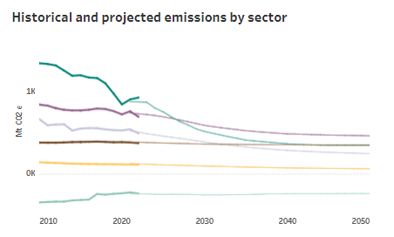
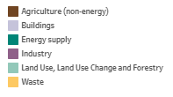
Projections
Article 18 (1)(b) – National projections of greenhouse gases
By 15 March 2025 and every second year thereafter, CPs shall report on their national projections of national greenhouse gas emissions by sources and removals, organized by gas or groups of gases.
Reports due: | 15 March – Biannually – To start in 2025

Slide 3
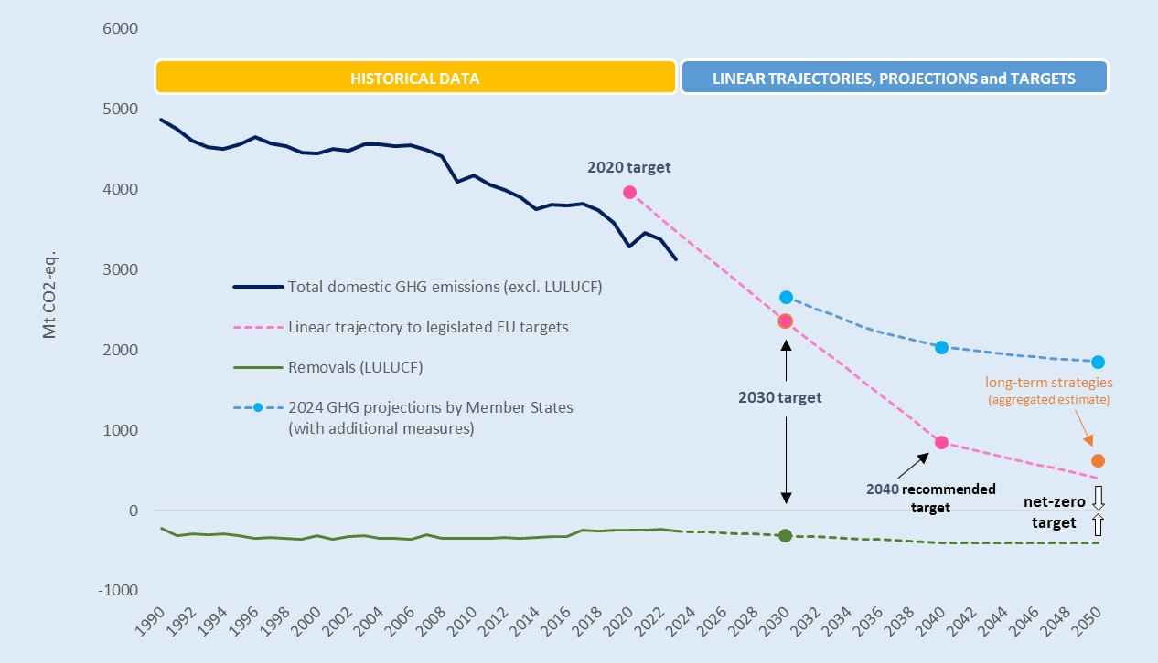
HOW IS THE REPORTED DATA USED – example from the EU data
GHG projections and PaMs
GHG inventory
nLTS and NECPr
GHG approximated
Notes:
For the Energy Community’s CPs, the adapted Governance Regulation sets common rules for planning, reporting and monitoring on energy and climate policies and targets, including via National Energy and Climate Plans. Targeted support is needed to ensure compliance, e.g. the quality of reported data, its comparability with EU data, and its appropriate compilation and analysis. The reporting requirements come gradually, with the first new obligations being introduced in 2023. These include reporting on national greenhouse gas policies and measures, national climate change adaptation planning and strategies, and the description of the national system for reporting on policies and measures and projections of anthropogenic GHG emissions. This will be expanded to include numerous data flows, including the greenhouse gas inventories and information on support to developing countries.
The nine CPs are the six West Balkan CPs of Albania, Bosnia and Herzegovina, North Macedonia, Kosovo, Montenegro, and Serbia, as well as the three Eastern Partnership members of the Energy Community: Georgia, the Republic of Moldova and Ukraine. The project includes both virtual and in-person training sessions where the targeted technical assistance will be provided.
A key partner of this community is the Energy Community Secretariat, which is coordinating the full scope of reporting under the adapted Governance Regulation and which will collect all final data sets for further communication. Moreover, the Secretariat is a key partner in the coordination of technical assistance of the project and aligning it with the broader support provided by the Energy Community Secretariat.

Slide 4
What to report on Projections?
Article 18 (1)(b) – National projections of greenhouse gases
What to report?
Reports due: | 15 March – Biannually – Since 2023
Table 5a-5b: LULUCF projections and ESR and LULUCF
Table 1a: GHG projections per sector, gas, and scenario
Table 1b: LULUCF projections – not included
Table 2: Indicators to monitor progress of PaMs
Table 3: Projections parameters and variables
(per scenario)
Table 4: Information on models
(also possible to report as webform)
Table 7: Key parameters for the sensitivity analysis
Table 6: Sensitvity analysis per sector

Slide 5


How to report on Projections?
You report through the template you find on Reportnet.
Table 1a – Per gas and per scenario
Table 2 - Indicators to monitor progress of PaMs
Table 3 - Projections parameters and variables
Table 4 – Information on models
Table 7 – Key parameters for the sensitivity analysis

Slide 6

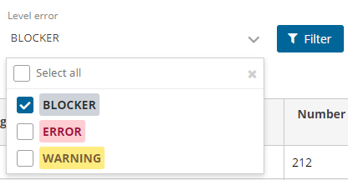
Projections Quality Control Process
Legend
Process in Reportnet
Process outside of Reportnet
Fill in Excel template
Upload to Reportnet
Release to data collection
External QA/QC
Resubmit (if needed)
Illustration of validation in Reportnet
Use QA/QC sheets in Excel template
Reportnet validation

Slide 7
Exercise for how to report on Projections
Using the reporting templates I will send to you – please send me an email:
Per.wretlind@eea.europa.eu
Please fill them in with as much information that you find relevant in the draft version of the BTR, if this is available?

